Slide 1

OAAA’s Role in National Institutional and Program Accreditation
IQA Workshop: Quality in Higher Education
28-29 May 2015, Kyrenia-North Cyprus
Oman Academic Accreditation Authority (OAAA)

Slide 2

Briefing Outline
OAAA
Historical context of Oman’s HE sector
About the OAAA
OAAA’s role in accrediting HEIs
  Stage 1: Quality Audits
  Stage 2: Standards Assessments
OAAA’s role in accrediting programs
  General Foundation Programs
Key points

Slide 3

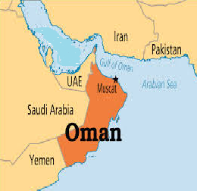

Slide 4
Historical context of
Oman’s HE sector
Notes:
4

Slide 5
Historical context of
Oman’s HE sector
OAAA
1970s & 1980s: Government colleges established, offering certificate and diploma programs in the national priorities of health, teaching and technical skills.
1986: Sultan Qaboos University established, the first (and only) comprehensive university.
1990s: Oman started importing higher education; today there are 27 private HEIs, including universities, university colleges and colleges
New public and private universities in development

Slide 6
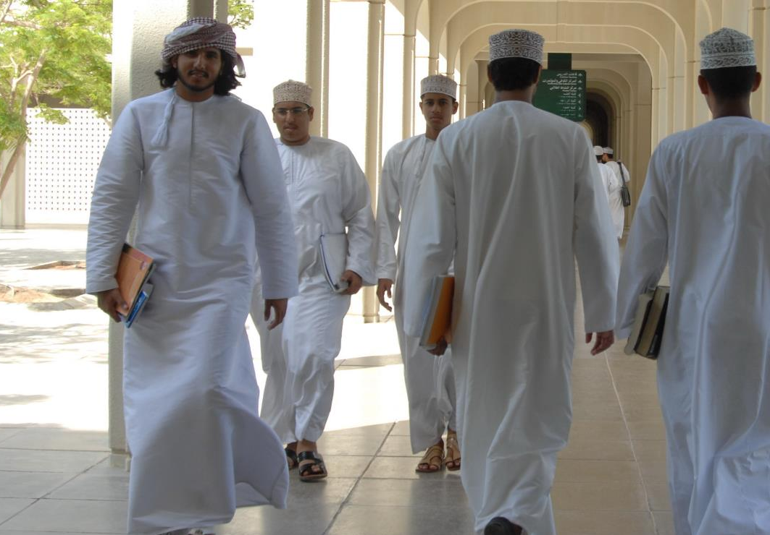
In 2015, there are over 60 public and private institutions offering post secondary education leading to higher education qualifications

Slide 7
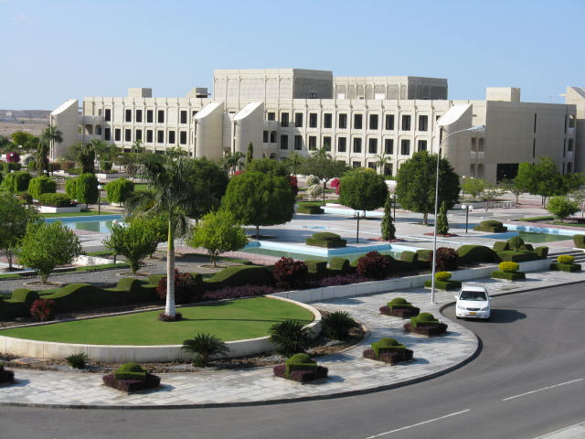
Sultan Qaboos University, Oman’s public university, established in 1986

Slide 8
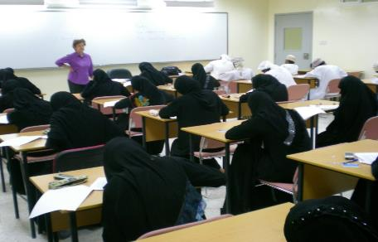

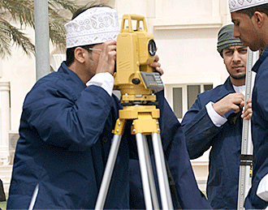

Oman Public Sector HEIs
OAAA
Colleges of Applied Sciences
Ministry of Health Institutes
Colleges of Technology
Ministry of Defence Institutes

Slide 9

Private university colleges and colleges are required to have an overseas affiliate to support the development of their quality management systems

Slide 10
About the OAAA
Notes:
10

Slide 11
OAAA
OAAA
Originally established by Royal Decree as the Oman Accreditation Council (OAC) in 2001
OAC was replaced by OAAA in 2010
OAAA is now an independent (in terms of administration and finance) government entity
OAAA is governed by OAAA Board, but acts in collaboration with Ministry of Higher Education and other stakeholders
Reports to the Education Council

Slide 12
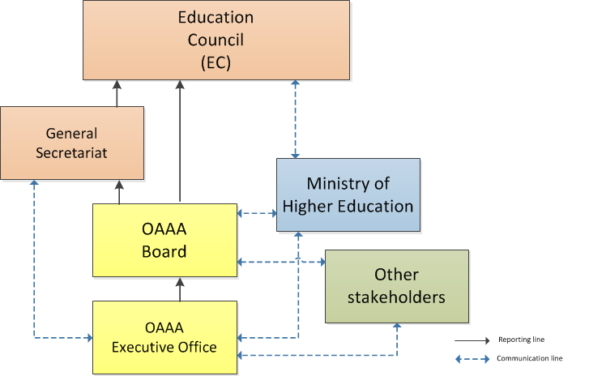
OAAA reporting and communication 2010 onward
OAAA

Slide 13
OAAA Roles & Responsibilities
OAAA
Developing a system for institutional and program accreditation
Conducting Quality Audits of HEIs
Establishing a procedure for recognising foreign programs offered in Oman
Updating and maintaining the OQF
Accrediting public and private HEIs and academic programs
Securing mutual recognition with external QA agencies

Slide 14
OAAA’s role in accrediting higher education institutions
Notes:
14

Slide 15
Background
OAAA
First iteration of institutional standards and accreditation process was developed as part of the Requirements for Oman’s System of Quality Assurance (ROSQA), introduced in 2004
In 2004/2005 two HEIs and their programs went through the accreditation process
The results of these processes and initial feedback from the sector suggested that a review of the approach was necessary.
A review was carried out in 2006 and the outcomes suggested that the sector needed support to meet internationally-benchmarked standards.
In 2008, a two-stage process institutional accreditation process was initiated.

Slide 16
HEI QA Processes
OAAA
First cycle
commenced
HEI Accreditation
HEI Licensure
2008
Stage
1
:
Quality
Audit
4 years
≤4 years
Appeal
HEI Accreditation
HEI Accreditation
Certificate
Met
Stage
2
:
Standards
Assessment
KEY
Not met
1-2 years on
Probation
Start/End
Process
Met
HEI Standards
HEI
Accreditation
Terminated
Reassessment
Document
Notes:
16

Slide 17
HEI Accreditation Scope
OAAA
1. Governance and Management
2. Student Learning by Coursework Programs
3. Student Learning by Research Programs
4. Staff Research and Consultancy
5. Industry and Community Engagement
6. Academic Support Services
7. Students and Student Support Services
8. Staff and Staff Support Services
9. General Support Services and Facilities

Slide 18
Institutional Accreditation Stage 1:
Quality Audits
Notes:
18

Slide 19
HEI QA Processes
OAAA
HEI Accreditation
Stage 1:
Quality
Audit
4 years
≤4 years
HEI Accreditation
HEI Accreditation
Certificate
Pass
Stage 2:
Standards
Assessment
STAGE 1: QUALITY AUDIT
Self Study
External Review
Quality Audit
External
Quality Audit
Self Study
Portfolio
Review
Report
Activities
Activities

Slide 20
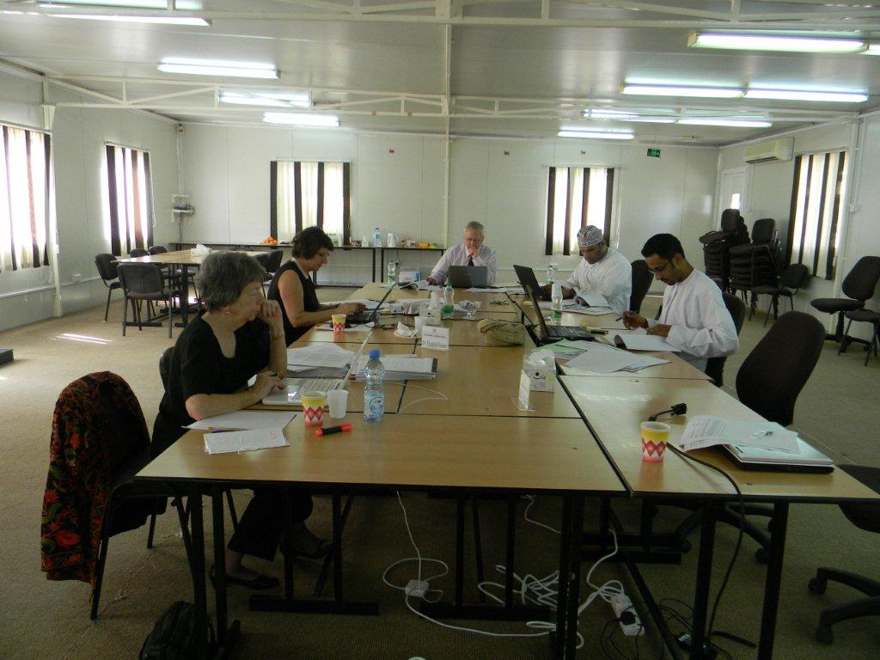
A Quality Audit Panel at work
To date, over 50 institutions have been through Quality Audit and reports are published on the OAAA website. By the end of 2015, over 90% of public and private HEIs will have gone through the quality audit process.
Notes:
20

Slide 21
Quality Audits
OAAA
Formative approach (does not result in a pass/fail)
Encourages HEIs to develop their individual quality management systems while informing public about quality
Each HEI is evaluated against own stated Mission and objectives
Use of locally-based as well as international reviewers so Panel understands local diversity
Formal conclusions (Commendations, Affirmations, Recommendations) recognise diversity of each HEI’s provision.
Resulting reports published on OAAA website www.oaaa.gov.om

Slide 22
Institutional Accreditation Stage 2:
Standards Assessments
Notes:
22

Slide 23
HEI QA Processes
OAAA
HEI Accreditation
Stage 1
:
Quality
Audit
4 years
≤4 years
HEI Accreditation
HEI Accreditation
Certificate
Pass
Stage 2:
Standards
Assessment
STAGE 2: STANDARDS ASSESSMENT
Self Study
External Review
Self Study
Assessment
External
Accreditation
Activities
Application
Review
Decision
Activities

Slide 24
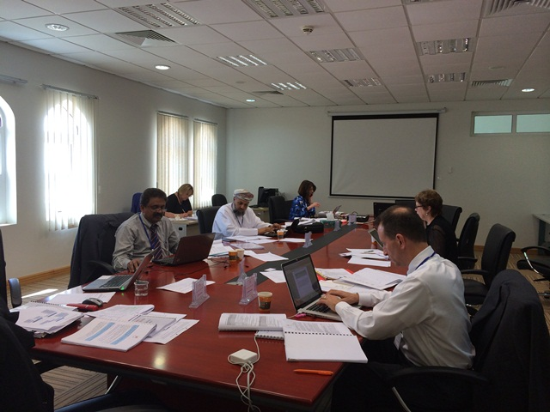
A pilot Standards Assessment Panel at work
The OAAA has carried out four pilot Standards Assessments, two institutional and two program, to test its proposed processes

Slide 25

Institutional Standards Assessment
OAAA
Second stage following Quality Audits
An internationally-benchmarked set of standards and criteria based on the institutional accreditation scope have been developed
Comprehensive consultative process including representatives from HEIs; government organisations; professional bodies; international experts; students and employers
Finally approved standards available on the OAAA website
Pilots taking place in 2014/2015
Formal Standards Assessments to take place late 2015/early 2016

Slide 26
What is the difference between HEI Quality Audit and Standards Assessment?
OAAA
Quality Audit | Standards Assessment
Evaluates the HEI’s effectiveness against its own stated Mission and Goals | Evaluates the HEI’s effectiveness against a set of nine national standards which are applied to every HEI operating in Oman
Results in Recommendations, Affirmations and Commendations which help to develop the emerging HE sector in Oman | Results in accreditation decision and evaluates response made to Recommendations and Affirmations and how Commendations have been maintained/strengthened
Formative in nature | Summative in nature

Slide 27
OAAA’s role in
Program Accreditation
Notes:
27

Slide 28
Program QA Processes
OAAA

Slide 29
Program Accreditation
OAAA
Program accreditation process is based on a set of internationally-benchmarked generic standards
Scope of the program accreditation is informed by the scope of the institutional accreditation
Standards have been developed through a comprehensive consultative process including representatives from HEIs; government organisations; professional bodies; international experts; students and employers
Draft approach and standards available on the OAAA website
Program accreditation pilots taking place in 2014/2015

Slide 30
Accreditation of General Foundation
Programs (GFPs)
Notes:
30

Slide 31
What is a GFP?
OAAA
A formal, structured, generic program of study in English, Mathematics, Computing & Study Skills.
Designed to prepare students for their higher education studies
It does not earn the student higher education credit and is not a terminal qualification.
Successful completion qualifies the student for admission into a higher education institution and entry into programs (some programs may have additional entry criteria).
Over half of students currently in higher education in Oman are enrolled on a GFP

Slide 32
What are Foundation standards?
OAAA
Developed 2007/2008 by the OAAA with HE professionals in working groups in Oman with external consultants
Lengthy consultative process – through web-site discussion board and national symposium where feedback was taken into account
Set the minimum standards that students are expected to attain
Primary focus on student learning outcomes (SLOs): Standards based on SLOs
Standards are not curricula – each HEI to develop the curriculum, teach and assess students

Slide 33
GFP Accreditation Phases
OAAA
OAAA is in the process of developing a three stage process to the eventual accreditation of GFPs:
  Phase one: audit of GFPs
  Phase two: revision of GFP standards
  Phase three: accreditation of GFPs (against internationally-benchmarked standards)
Pilot GFP Audits will be started in September 2015
First GFP Audits will commence in 2016
Executive Summaries of GFP Audit Reports will be published on the OAAA website in Arabic and English

Slide 34
Key points
Notes:
34

Slide 35
Key points
OAAA
The OAAA is an independent government entity which is responsible for the accreditation of institutions and programs in the higher education sector
Over 90% of HEIs have been through Institutional Accreditation Stage 1: Quality Audits; reports are published on the OAAA website
Up until now, no institutions or programs have been accredited by the OAAA
Institutional Accreditation Stage 2: Standards Assessments will commence late 2015/early 2016
GFP Audits will commence 2016
All outcomes will be published on the OAAA website
35

Slide 36
Thank you!
www.oaaa.gov.om

